Slide 1
Chapter 25 All-Pairs Shortest Paths
Chi-Yeh Chen
陳奇業
成功大學資訊工程學系

Slide 2
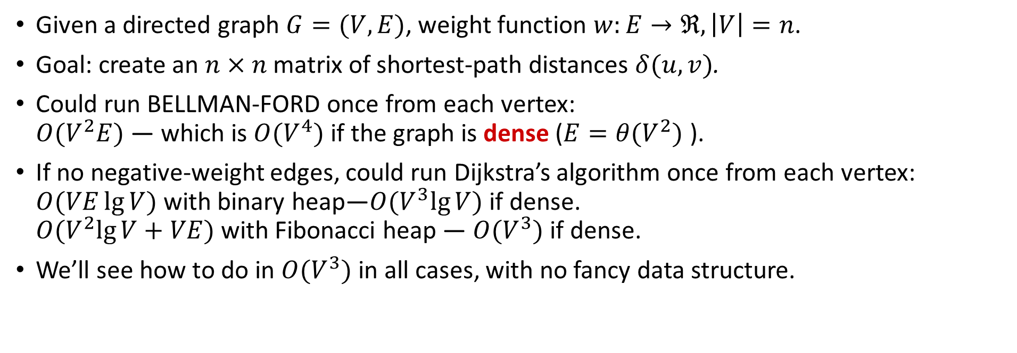
Overview
Given a directed graph $G=(V,E)$, weight function $w:E→ℜ,\left|V\right|=n$.
Goal: create an $n×n$matrix of shortest-path distances $δ(u, v)$.
Could run BELLMAN-FORD once from each vertex: $O{(V}^{2}E)$— which is $O{(V}^{4})$if the graph is dense (${E=θ(V}^{2})$).
If no negative-weight edges, could run Dijkstra’s algorithm once from each vertex: $O(VE\lg{V)}$ with binary heap—$O{(V}^{3}\lg{V)}$ if dense. $O{(V}^{2}\lg{V+VE)}$ with Fibonacci heap — $O{(V}^{3})$ if dense.
We’ll see how to do in $O{(V}^{3})$ in all cases, with no fancy data structure.

Slide 3
Shortest paths and matrix multiplication

Slide 4
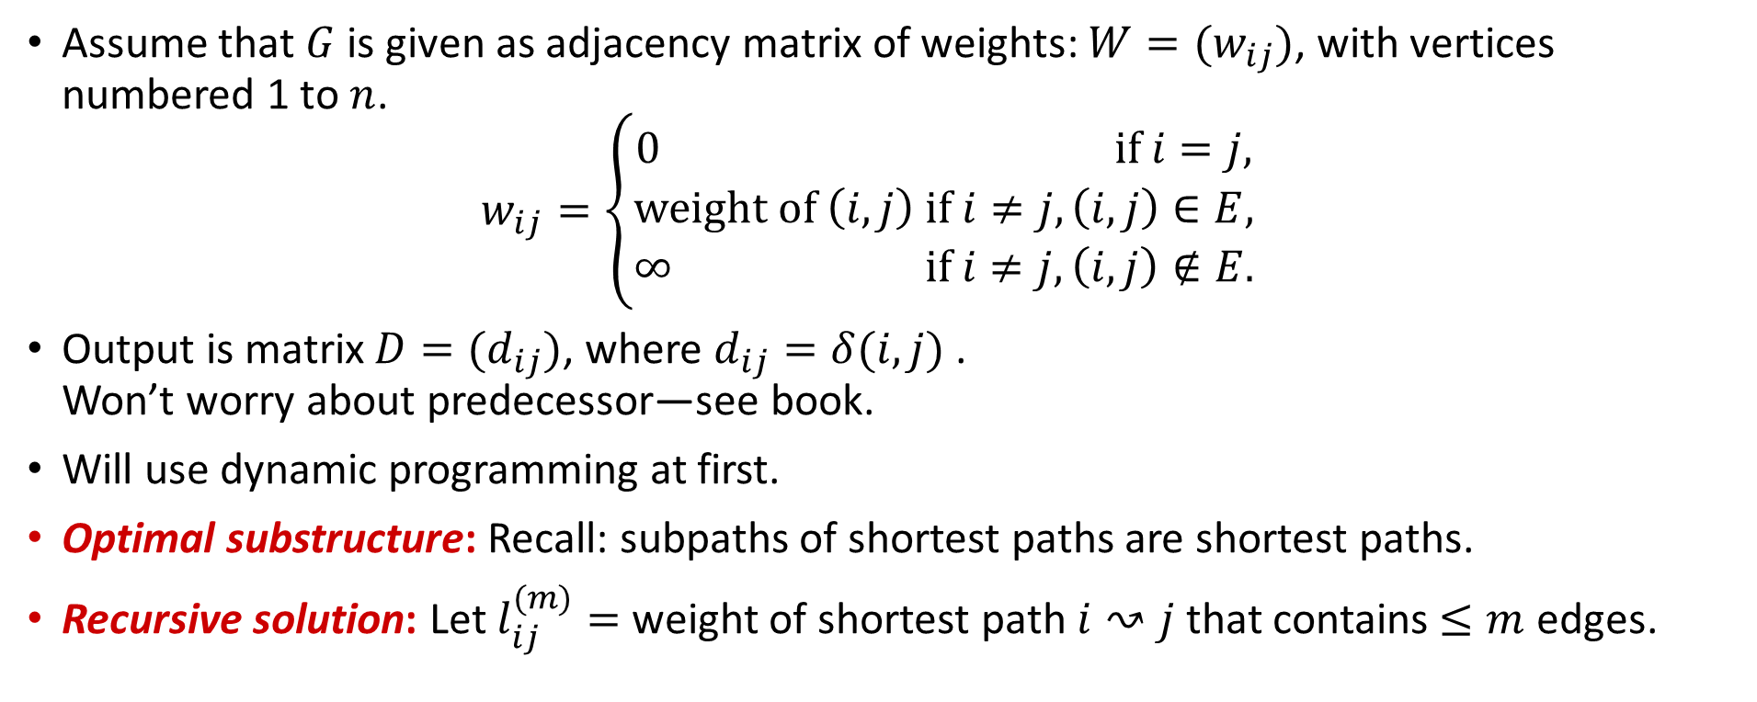
Shortest paths and matrix multiplication
Assume that $G$ is given as adjacency matrix of weights: $W=(w_{ij})$, with vertices numbered 1 to $n$. $w_{ij}=\left\{\begin{matrix}0 if i=j, \\ weight of \left(i,j\right) if i≠j,\left(i,j\right)∈E, \\ ∞ if i≠j,\left(i,j\right)∉E.\end{matrix}\right.$
Output is matrix $D=(d_{ij})$, where $d_{ij}=δ(i,j)$. Won’t worry about predecessor—see book.
Will use dynamic programming at first.
Optimal substructure: Recall: subpaths of shortest paths are shortest paths.
Recursive solution: Let $l_{ij}^{(m)}=$ weight of shortest path $i↝j$ that contains $≤m$ edges.

Slide 5
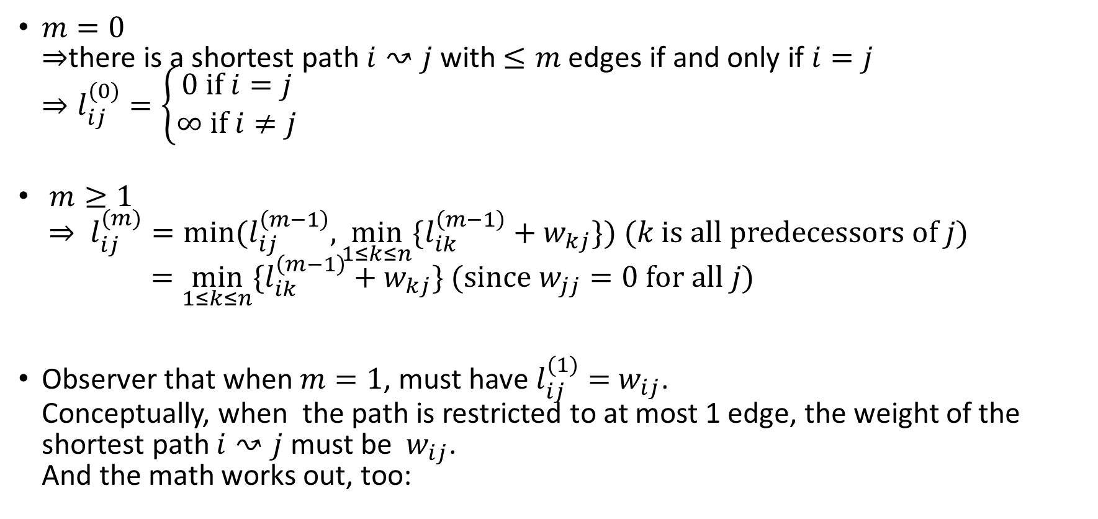
$m=0$ $⇒$there is a shortest path $i↝j$ with $≤m$ edges if and only if $i=j$ $⇒l_{ij}^{(0)}=\left\{\begin{matrix}0 if i=j \\ ∞ if i≠j\end{matrix}\right.$
$m≥1$ $⇒ l_{ij}^{(m)}=min⁡(l_{ij}^{\left(m−1\right)}, \min_{1≤k≤n}{\{l_{ik}^{\left(m−1\right)}+w_{kj}\}) (k is all predecessors of j)}$ $=\min_{1≤k≤n}{\{l_{ik}^{\left(m−1\right)}+w_{kj}\} (since{ w}_{jj}=0 for all j)}$
Observer that when $m=1$, must have $l_{ij}^{(1)}={ w}_{ij}$. Conceptually, when the path is restricted to at most 1 edge, the weight of the shortest path $i↝j$ must be ${ w}_{ij}$. And the math works out, too:

Slide 6
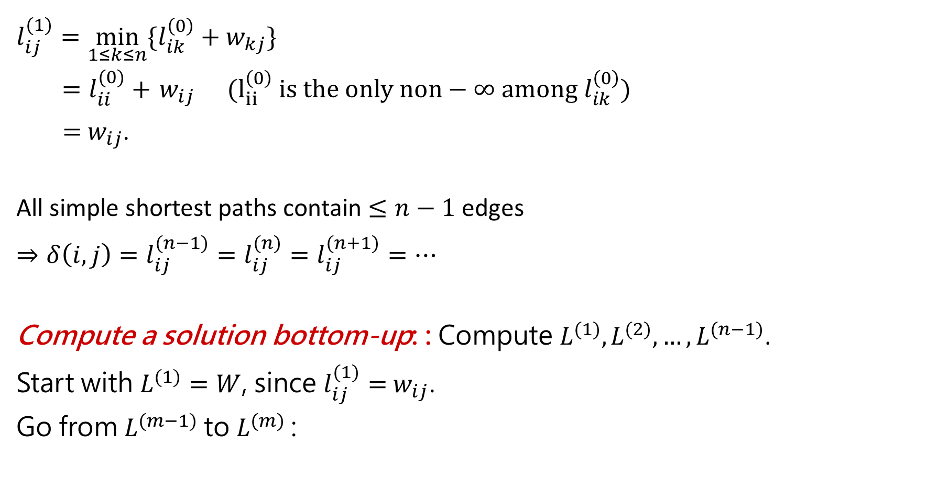
$$l_{ij}^{(1)}=\min_{1≤k≤n}{\{l_{ik}^{\left(0\right)}+w_{kj}\}}$$
$=l_{ii}^{(0)}+{ w}_{ij} (l_{ii}^{\left(0\right)} is the only non−∞ among l_{ik}^{\left(0\right)})$
$={ w}_{ij}$.
All simple shortest paths contain $≤n−1$ edges
$$⇒δ\left(i,j\right)=l_{ij}^{(n−1)}=l_{ij}^{(n)}=l_{ij}^{(n+1)}=…$$
Compute a solution bottom-up: : Compute $L^{(1)},L^{(2)},…,L^{(n−1)}$.
Start with $L^{(1)}=W$, since $l_{ij}^{(1)}={ w}_{ij}$.
Go from $L^{(m−1)}$to $L^{(m)}$:

Slide 9

Time:
EXTEND: $Θ(n^{3})$.
SLOW-APSP: $Θ(n^{4})$.
Observation: EXTEND is like matrix multiplication:
$$L→A$$
$$W→B$$
$$L’→C$$
$$min→+$$
$$+→．$$
$$∞→0$$

Slide 10
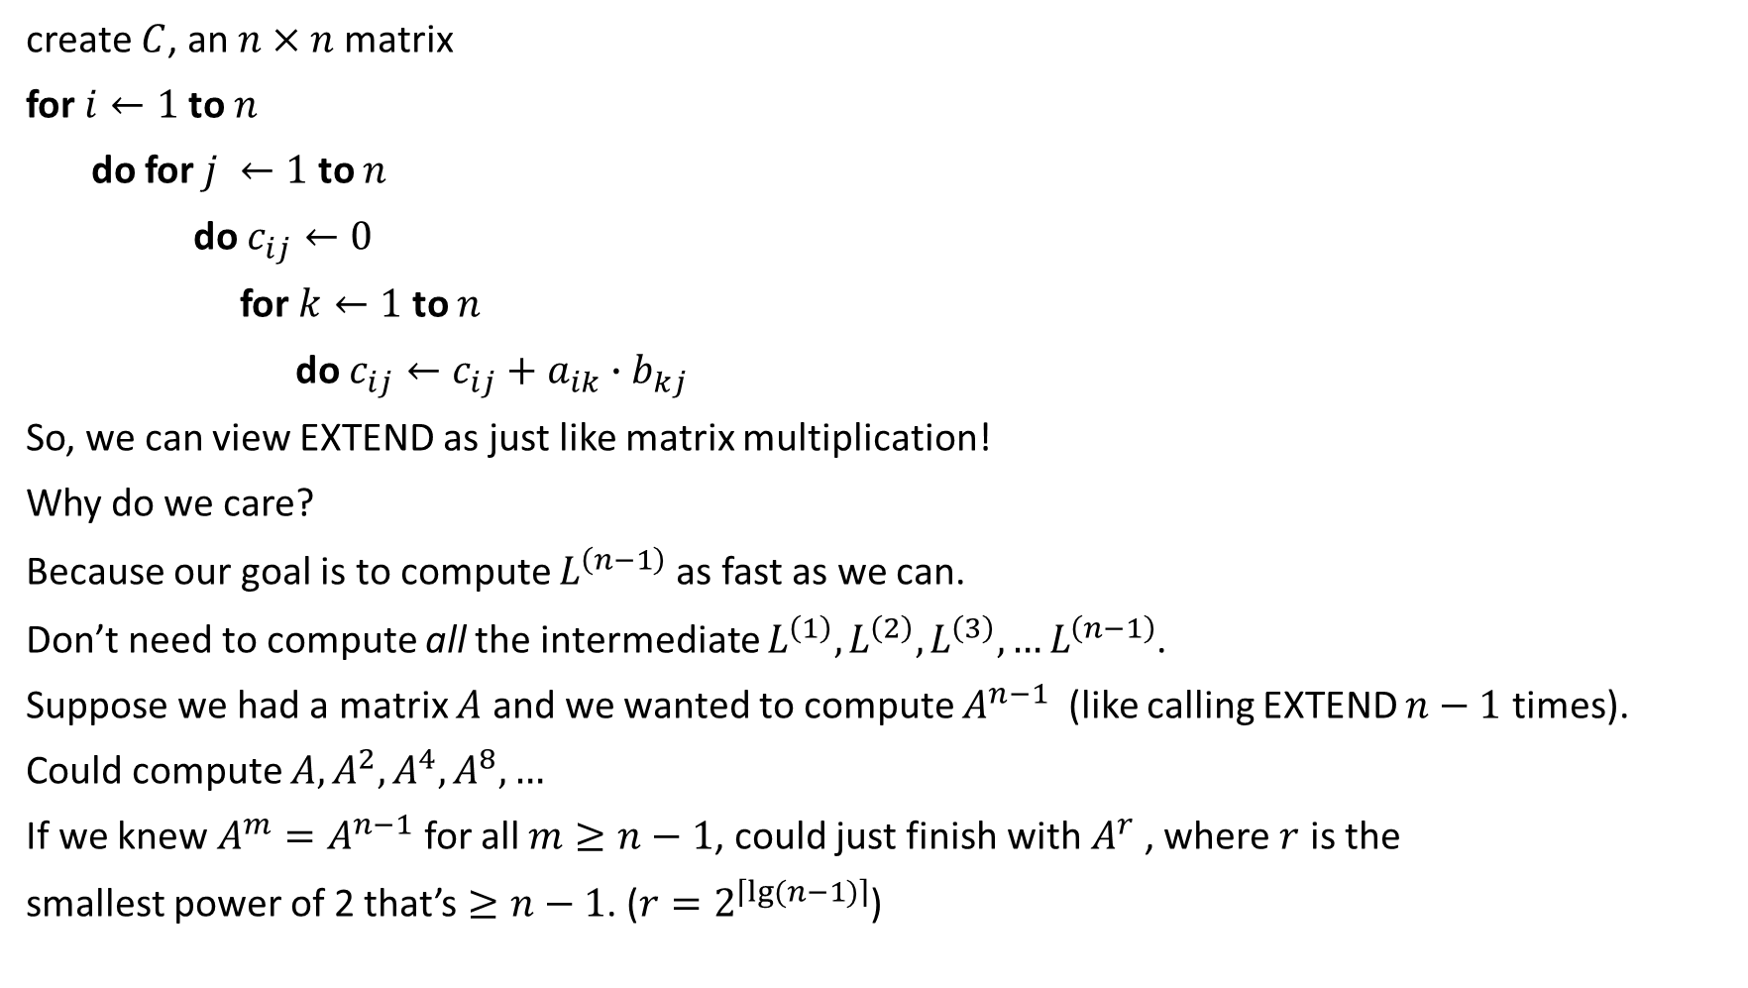
create $C$, an $n×n$matrix
for $i←1$to $n$
do for $j ←1$ to $n$
do $c_{ij}←0$
for $k←1$ to $n$
do $c_{ij}←c_{ij}+a_{ik}∙b_{kj}$
So, we can view EXTEND as just like matrix multiplication!
Why do we care?
Because our goal is to compute $L^{\left(n−1\right)}$as fast as we can.
Don’t need to compute all the intermediate $L^{\left(1\right)},L^{\left(2\right)},L^{\left(3\right)},…L^{\left(n−1\right)}$.
Suppose we had a matrix $A$ and we wanted to compute $A^{n−1}$ (like calling EXTEND $n−1$ times).
Could compute $A,A^{2},A^{4},A^{8},…$
If we knew $A^{m}=A^{n−1}$ for all $m≥n−1$, could just finish with $A^{r}$, where $r$ is the
smallest power of 2 that’s $≥n−1$. ($r=2^{\left\lceil \lg{(n−1)}\right\rceil }$)

Slide 11

OK to overshoot, since products don’t change after $L^{\left(n−1\right)}$.
Time: $Θ(n^{3}\lg{n})$

Slide 12
The Floyd-Warshall algorithm

Slide 13

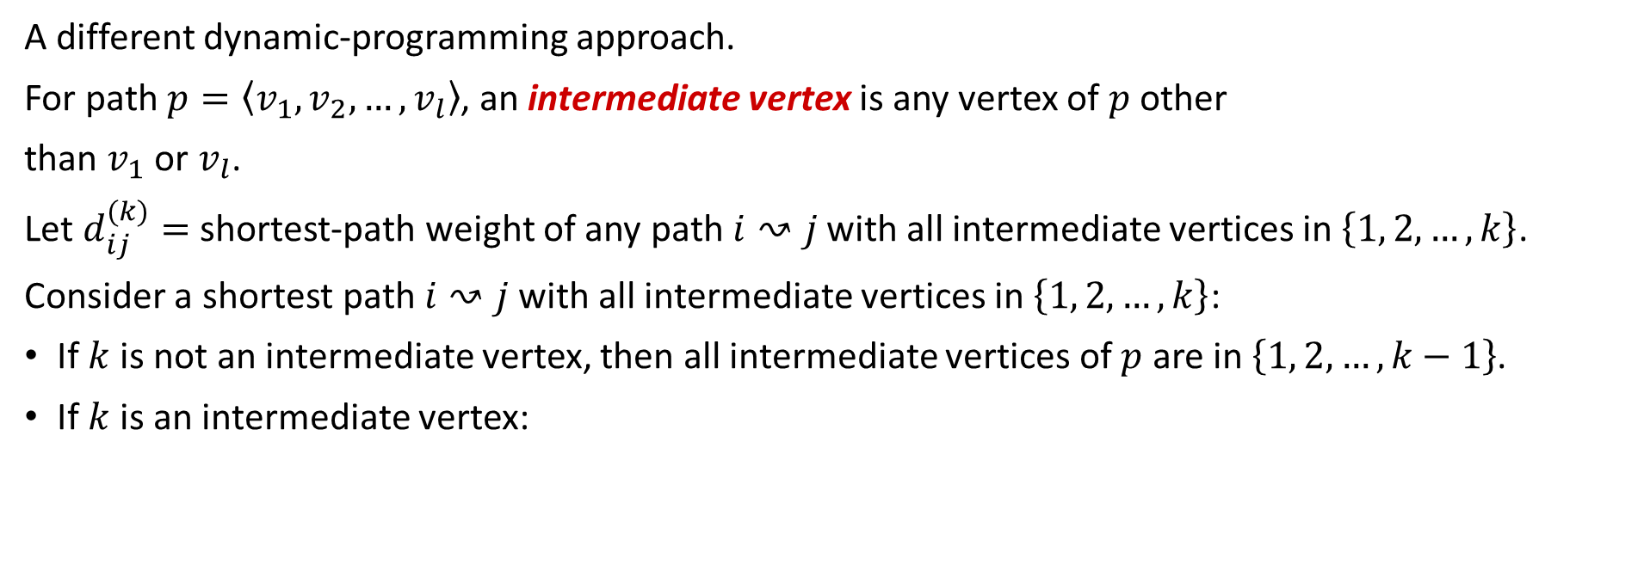
Floyd-Warshall algorithm
A different dynamic-programming approach.
For path $p=\left\langle v_{1},v_{2},…,v_{l}\right\rangle$, an intermediate vertex is any vertex of $p$ other
than $v_{1}$ or $v_{l}$.
Let $d_{ij}^{(k)}=$ shortest-path weight of any path $i↝j$ with all intermediate vertices in $\left\{1, 2,…,k\right\}$.
Consider a shortest path $i↝j$ with all intermediate vertices in $\left\{1, 2,…,k\right\}$:
If $k$ is not an intermediate vertex, then all intermediate vertices of $p$ are in $\left\{1, 2,…,k−1\right\}$.
If $k$ is an intermediate vertex:
$$p$$

Slide 14
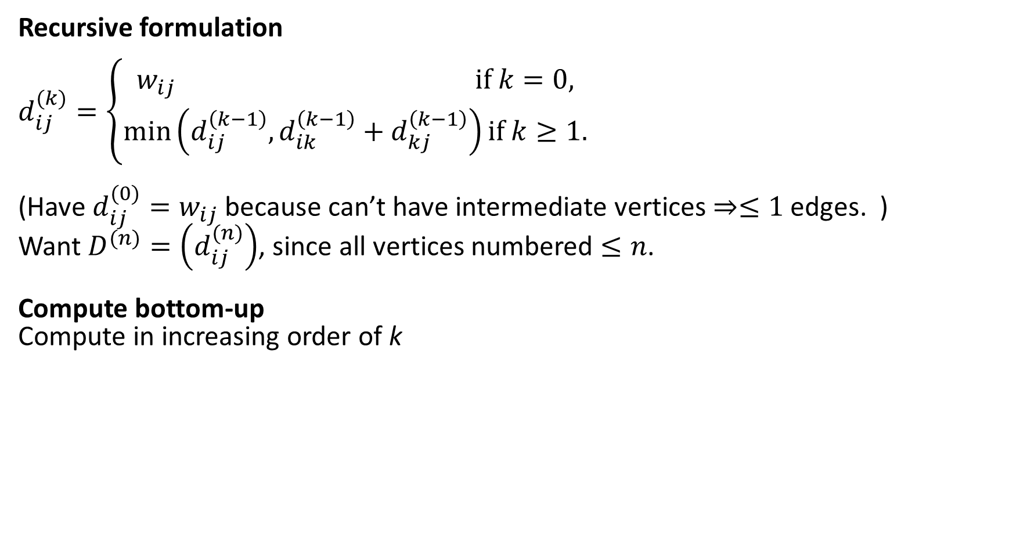
Recursive formulation
$$d_{ij}^{(k)}=\left\{\begin{matrix}w_{ij} if k=0, \\ \min\left(d_{ij}^{\left(k−1\right)},d_{ik}^{\left(k−1\right)}+d_{kj}^{\left(k−1\right)}\right)if k≥1.\end{matrix}\right.$$
(Have $d_{ij}^{(0)}=w_{ij}$ because can’t have intermediate vertices $⇒≤1$ edges. )
Want $D^{(n)}=\left(d_{ij}^{(n)}\right)$, since all vertices numbered $≤n$.
Compute bottom-up
Compute in increasing order of k

Slide 16
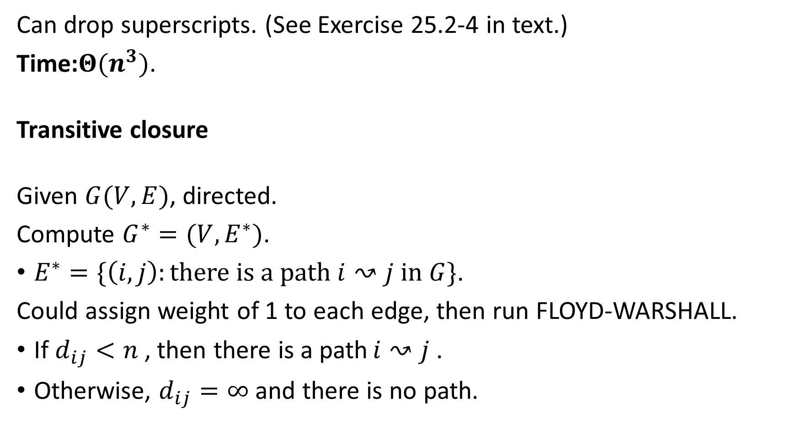
Can drop superscripts. (See Exercise 25.2-4 in text.)
Time:$Θ(n^{3})$.
Transitive closure
Given $G(V,E)$, directed.
Compute $G^{∗}=(V,E^{∗})$.
$E^{∗}=\{\left(i,j\right):there is a path i↝j in G\}$.
Could assign weight of 1 to each edge, then run FLOYD-WARSHALL.
If $d_{ij}<n$, then there is a path $i↝j$.
Otherwise, $d_{ij}=∞$and there is no path.

Slide 17
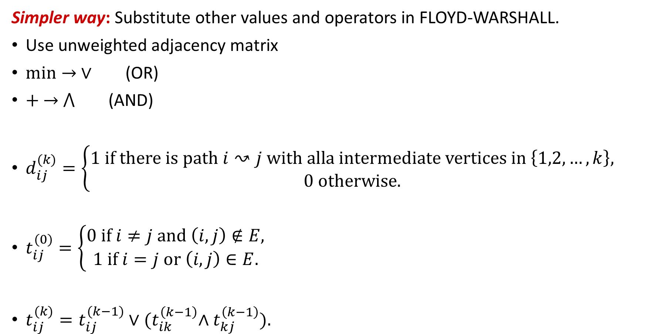
Simpler way: Substitute other values and operators in FLOYD-WARSHALL.
Use unweighted adjacency matrix
$min→ ∨$ (OR)
$+ →$ $⋀$ (AND)
$d_{ij}^{(k)}=\left\{\begin{aligned}1 if there is path i↝j with alla intermediate vertices in \left\{1,2,…,k\right\}, \\ 0 otherwise.\end{aligned}\right.$
$t_{ij}^{(0)}=\left\{\begin{aligned}0 if i≠j and \left(i,j\right)∉E, \\ 1 if i=j or \left(i,j\right)∈E.\end{aligned}\right.$
$t_{ij}^{(k)}=t_{ij}^{(k−1)}∨{(t}_{ik}^{\left(k−1\right)}∧t_{kj}^{\left(k−1\right)}).$

Slide 19

Time: $(n^{3})$, but simpler operations than FLOYD-WARSHALL.

Slide 20
Johnoson’s algorithm for sparse graphs

Slide 21
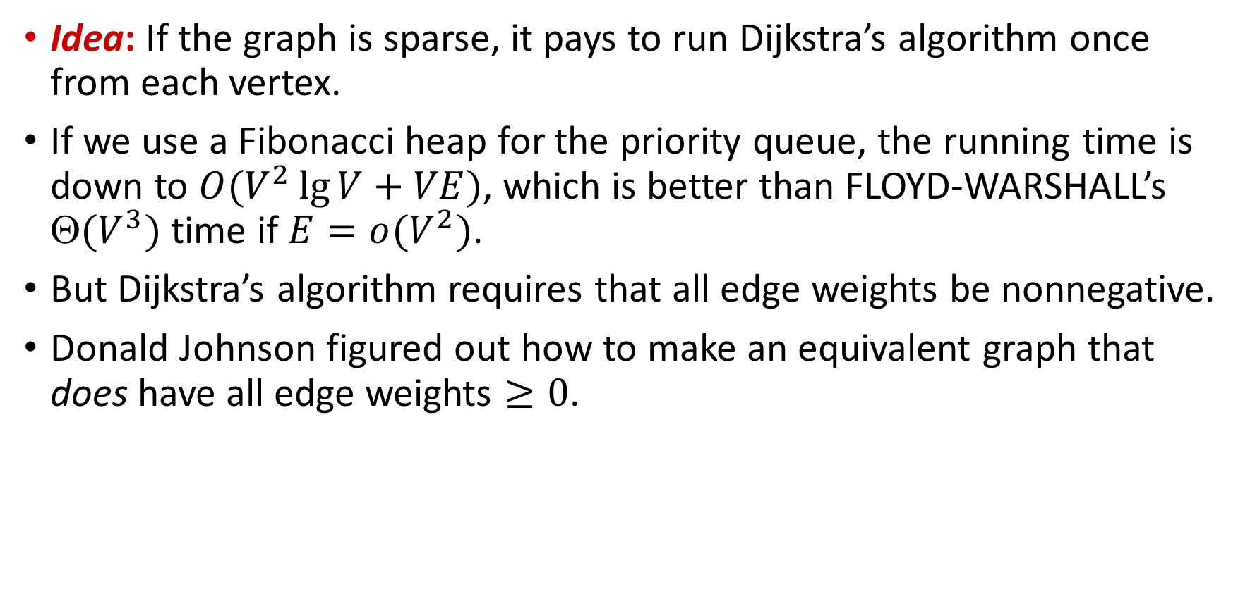
Idea: If the graph is sparse, it pays to run Dijkstra’s algorithm once from each vertex.
If we use a Fibonacci heap for the priority queue, the running time is down to $O(V^{2}\lg{V+VE})$, which is better than FLOYD-WARSHALL’s $(V^{3})$time if $E=o(V^{2})$.
But Dijkstra’s algorithm requires that all edge weights be nonnegative.
Donald Johnson figured out how to make an equivalent graph that does have all edge weights $≥0$.

Slide 22
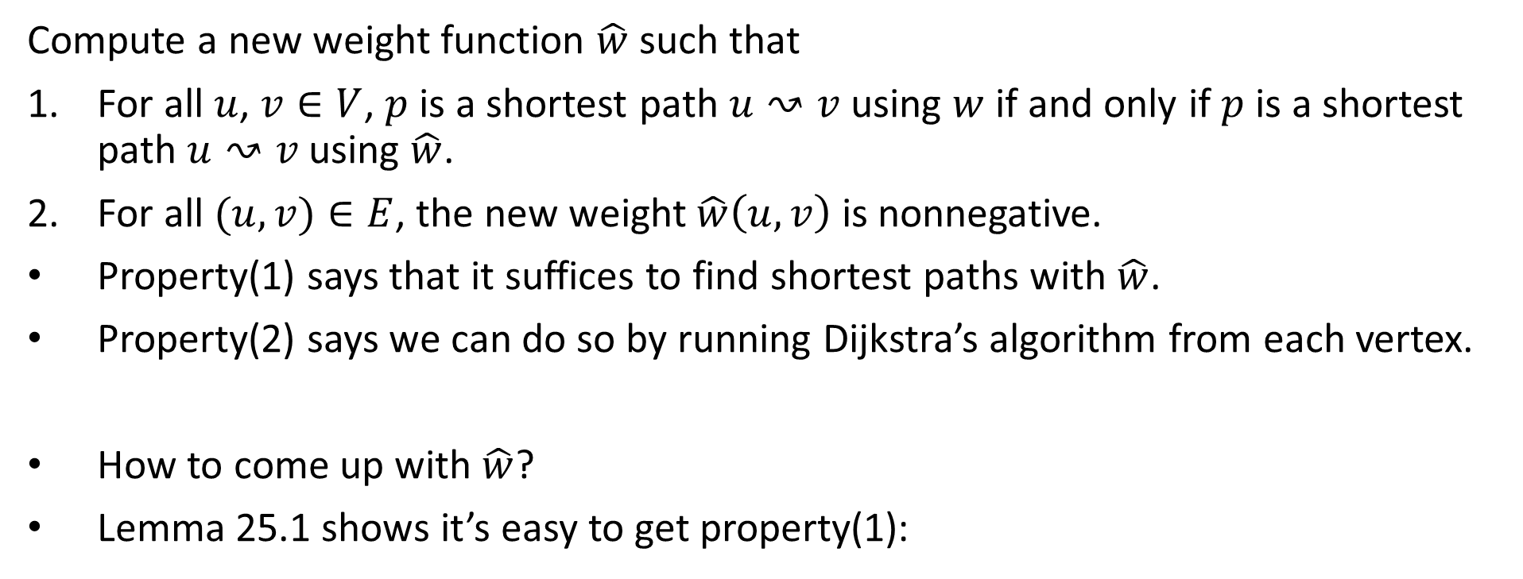
Reweighting
Compute a new weight function $\hat{w}$ such that
For all $u$, $v∈V$, $p$ is a shortest path $u↝v$ using $w$ if and only if $p$ is a shortest path $u↝v$ using $\hat{w}$.
For all $(u, v)∈E$, the new weight $\hat{w}\left(u, v\right)$ is nonnegative.
Property(1) says that it suffices to find shortest paths with $\hat{w}$.
Property(2) says we can do so by running Dijkstra’s algorithm from each vertex.
How to come up with $\hat{w}$?
Lemma 25.1 shows it’s easy to get property(1):

Slide 23
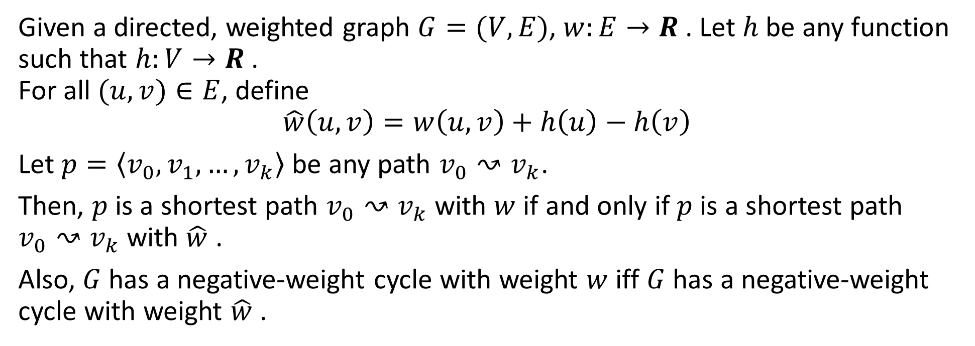
Lemma (Rewighting doesn’t change shortest paths)
Given a directed, weighted graph $G=(V,E)$, $w:E→R$. Let $h$ be any function such that $h:V→R$. For all $(u, v)∈E$, define
$$\hat{w}\left(u, v\right)=w\left(u, v\right)+h\left(u\right)−h\left(v\right)$$ Let $p=\left\langle v_{0},v_{1},…,v_{k}\right\rangle$ be any path $v_{0}↝v_{k}$.
Then, $p$ is a shortest path $v_{0}↝v_{k}$with $w$ if and only if $p$ is a shortest path $v_{0}↝v_{k}$with $\hat{w}$ .
Also, $G$ has a negative-weight cycle with weight $w$ iff $G$ has a negative-weight cycle with weight $\hat{w}$ .

Slide 24
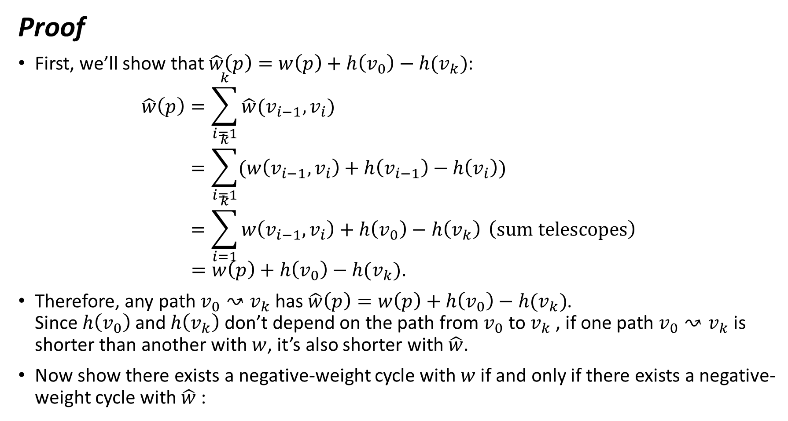
Proof
First, we’ll show that $\hat{w}\left(p\right)=w\left(p\right)+h\left(v_{0}\right)−h(v_{k})$: $\hat{w}\left(p\right)=\sum_{i=1}^{k}{\hat{w}(v_{i−1},v_{i})}$ $=\sum_{i=1}^{k}{(w\left(v_{i−1},v_{i}\right)+h\left(v_{i−1}\right)−h\left(v_{i}\right))}$ $=\sum_{i=1}^{k}{w\left(v_{i−1},v_{i}\right)+h\left(v_{0}\right)−h\left(v_{k}\right)} \left(sum telescopes\right)$ $=w\left(p\right)+h\left(v_{0}\right)−h(v_{k})$.
Therefore, any path $v_{0}↝v_{k}$has $\hat{w}\left(p\right)=w\left(p\right)+h\left(v_{0}\right)−h(v_{k})$. Since $h\left(v_{0}\right)$and $h\left(v_{k}\right)$ don’t depend on the path from $v_{0}$ to $v_{k}$, if one path $v_{0}↝v_{k}$is shorter than another with $w$, it’s also shorter with $\hat{w}$.
Now show there exists a negative-weight cycle with $w$ if and only if there exists a negative-weight cycle with $\hat{w}$:

Slide 25
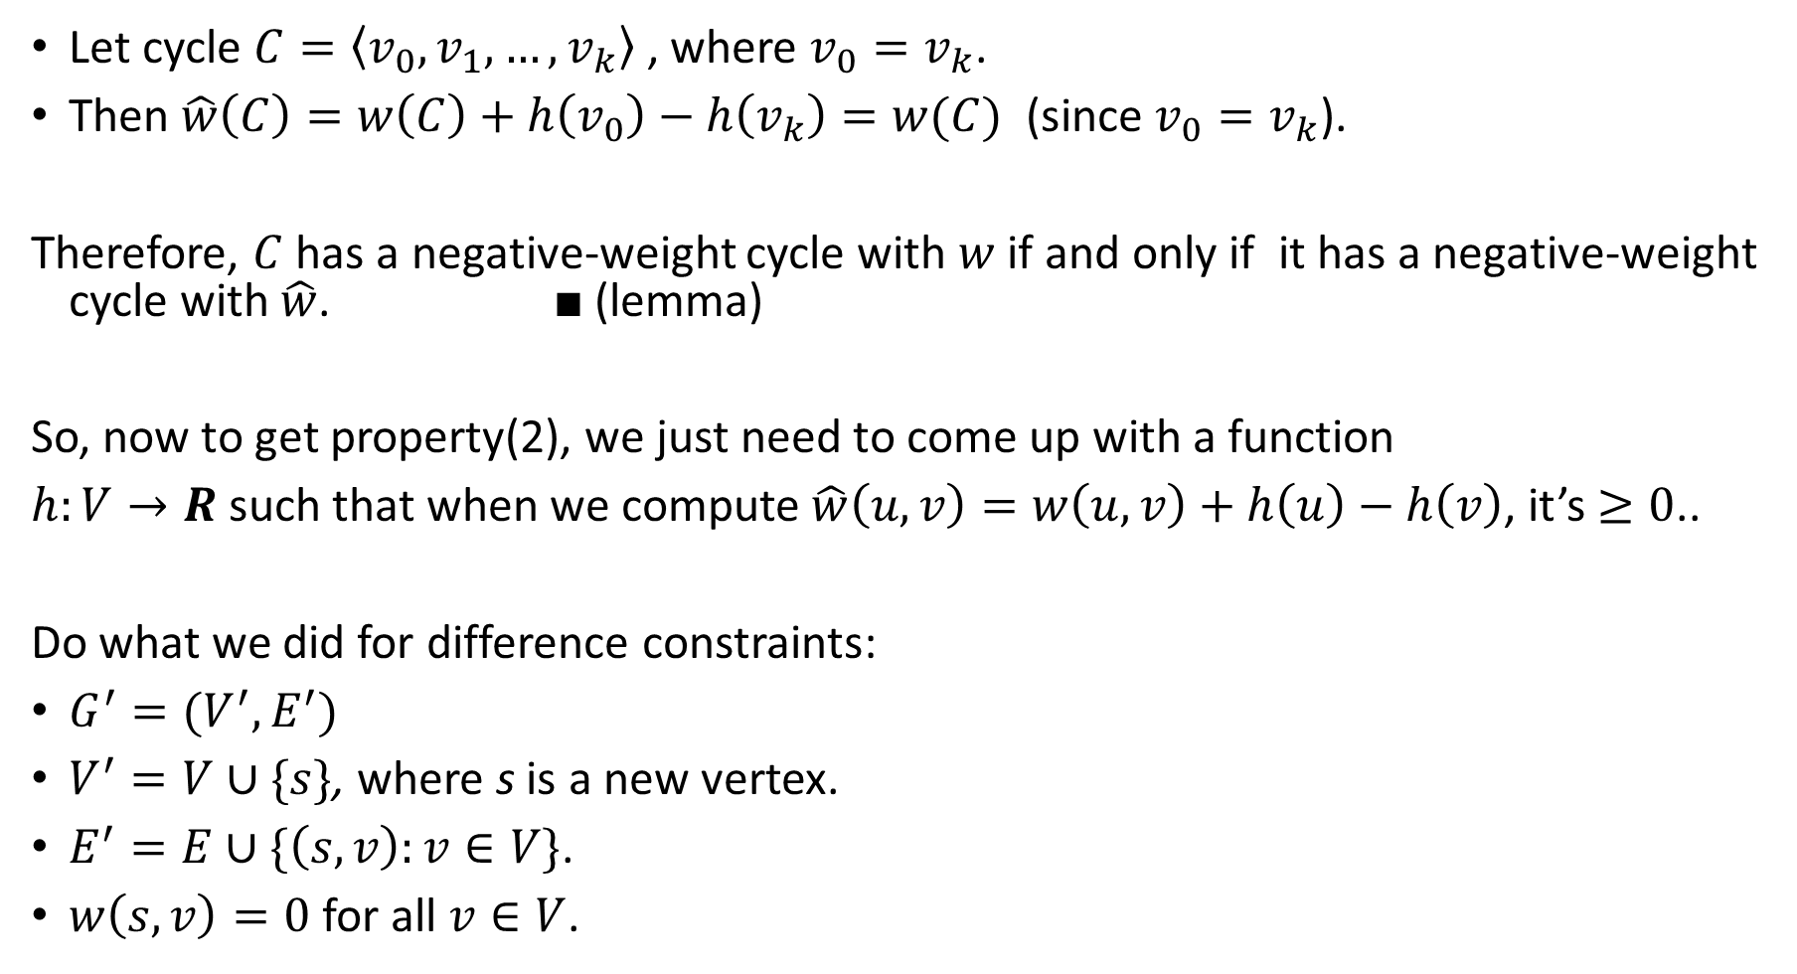
Let cycle $C=\left\langle v_{0},v_{1},…,v_{k}\right\rangle$, where $v_{0}=v_{k}$.
Then $\hat{w}\left(C\right)=w\left(C\right)+h\left(v_{0}\right)−h\left(v_{k}\right)=w(C)$ (since $v_{0}=v_{k}$).
Therefore, $C$ has a negative-weight cycle with $w$ if and only if it has a negative-weight cycle with $\hat{w}$. ■ (lemma)
So, now to get property(2), we just need to come up with a function
$h:V→R$such that when we compute $\hat{w}\left(u,v\right)=w\left(u,v\right)+h\left(u\right)−h\left(v\right)$, it’s $≥0$..
Do what we did for difference constraints:
$G^{′}=(V^{′},E^{′})$
$V^{′}=V∪\{s\}$, where s is a new vertex.
$E^{′}=E∪\{\left(s,v\right):v∈V\}$.
$w\left(s,v\right)=0$for all $v∈V$.

Slide 26




0
0
-1
a
3
4
s
0
0
8
-5
b
e
-4
2
-5
0
7
1
0
-4
0
c
d
6
Figure 25.6 Johnson’s all-pairs shortest-paths algorithm
(a) The graph G’ with the original weight function w. The new vertex s is black.

Slide 27
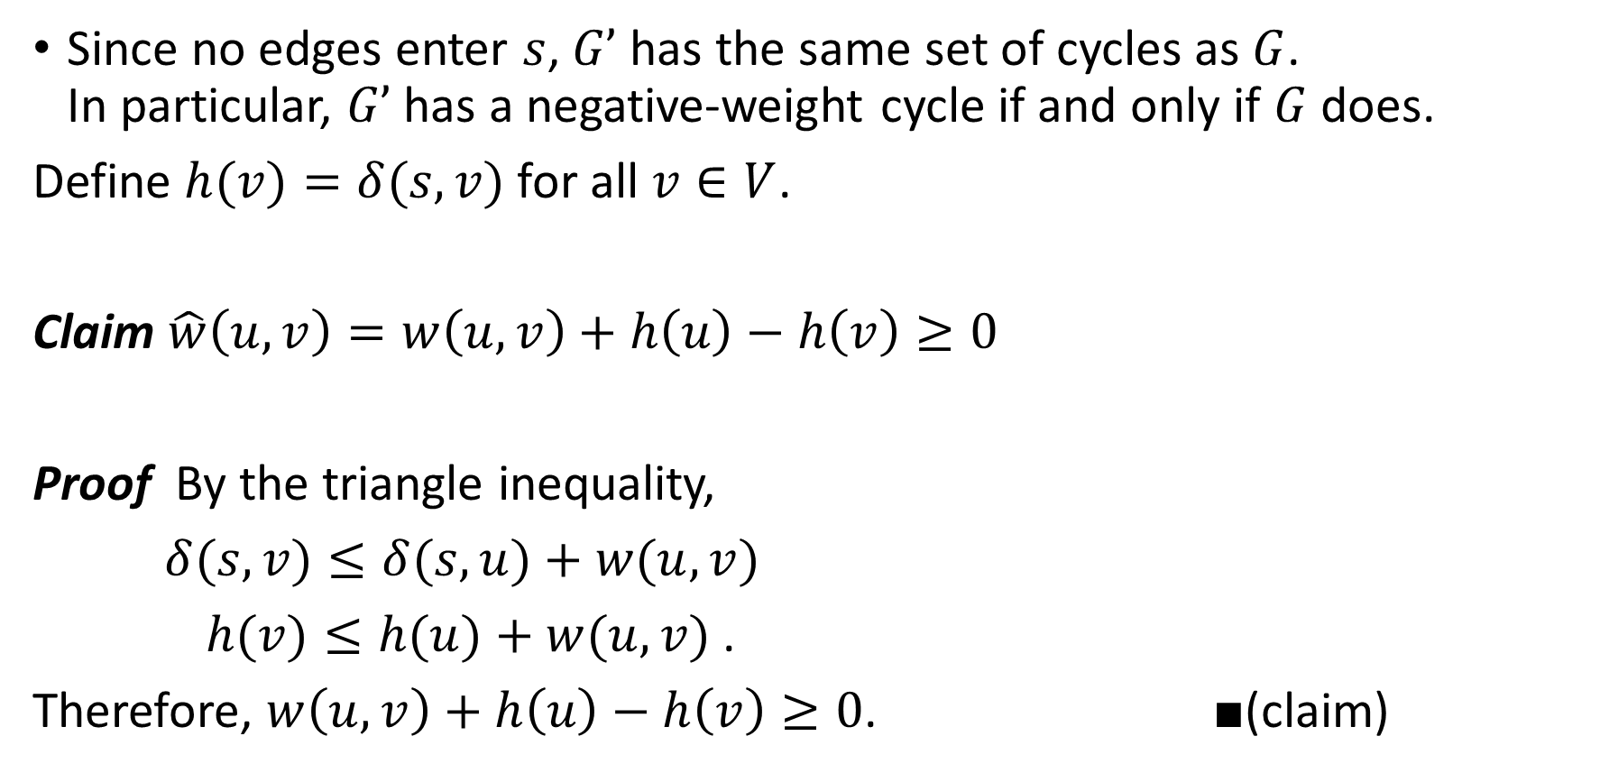
Since no edges enter $s$, $G’$ has the same set of cycles as $G$. In particular, $G’$ has a negative-weight cycle if and only if $G$ does.
Define $h(v)=δ(s, v)$for all $v∈V$.
Claim $\hat{w}\left(u,v\right)=w\left(u,v\right)+h\left(u\right)−h\left(v\right)≥0$
Proof By the triangle inequality,
$δ(s, v)≤δ(s, u)+w(u, v)$
$h(v)≤h(u)+w(u, v)$.
Therefore, $w\left(u,v\right)+h\left(u\right)−h\left(v\right)≥0$. ■(claim)

Slide 29
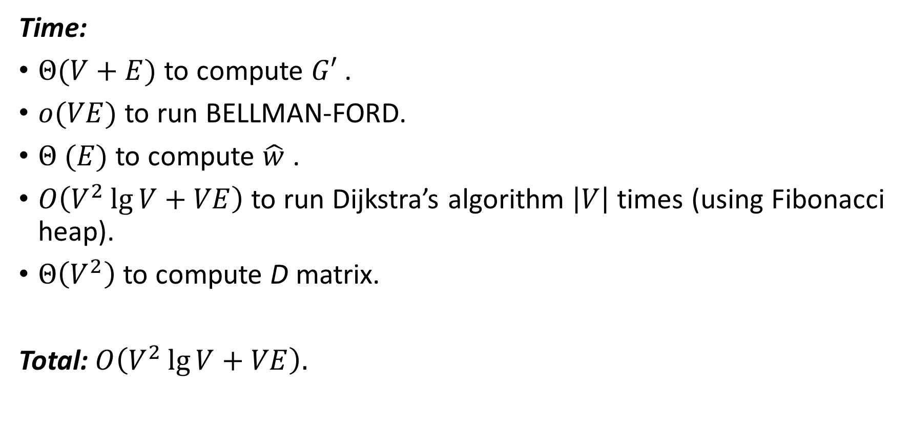
Time:
$Θ(V+E)$ to compute $G′$.
$o(VE)$ to run BELLMAN-FORD.
$Θ (E)$ to compute $\hat{w}$ .
$O\left(V^{2}\lg{V+VE}\right)$ to run Dijkstra’s algorithm $\left|V\right|$ times (using Fibonacci heap).
$Θ\left(V^{2}\right)$ to compute D matrix.
Total: $O\left(V^{2}\lg{V+VE}\right).$

